Slide 1
Population Health Management and Analytics Using Longitudinal, Comparative EHR Data
Allen Kamer
Co-Founder, Vice President
Corporate Development & Marketing

Slide 2
Humedica Vision
Transform disparate clinical data into the most actionable real-world insights to empower confident decision-making

Slide 3
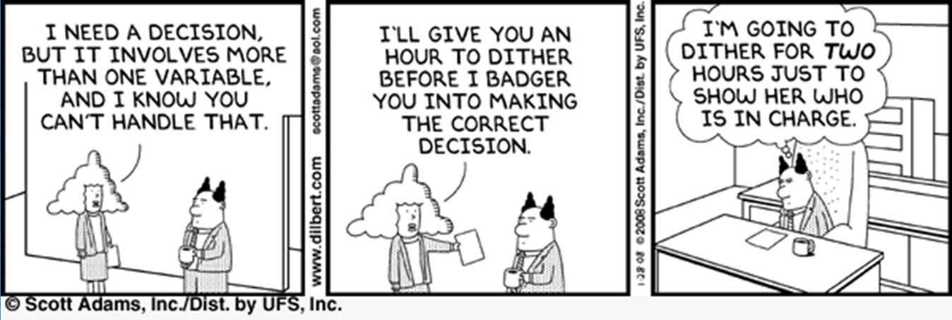
Business as Usual?

Slide 4
The Writing is on the Wall
Source: “The View from Healthcare’s Front Lines: An Oliver Wyman CEO Survey”

Slide 5

But Coordinated Care Will Be A Huge Challenge

Slide 6
Context
Most Significant Change Since Medicare & DRGs
Pundits Predict Doom (We have already failed once at this - Capitation)
Providers Will Assume Enormous Risk

Slide 7
What’s Different This Time?
Learned Lessons from Capitation
  We can’t just cut utilization
  We may need to trade some resources - e.g. more ambulatory care toe reduce ED use
  We have to maximize Cost-Benefit Equation or we face another consumer revolt
Risk = Unknown
  EMR’s provide far better data than the claims based sources we had last time
  Key is to leverage those clinical data alongside claims data

Slide 8

The Opportunities for Shared Savings are Specific & Well Understood
Shared Savings
$
Time
The…most promising areas for reducing Medicare costs in the near term, based on hard evidence, are efforts to
reduce the need for hospitalizations among beneficiaries with the most serious chronic illnesses
reduce hospital readmissions rates
reduce disparities across physicians and geographic areas in care delivery, utilization, and expenditures.

Slide 9
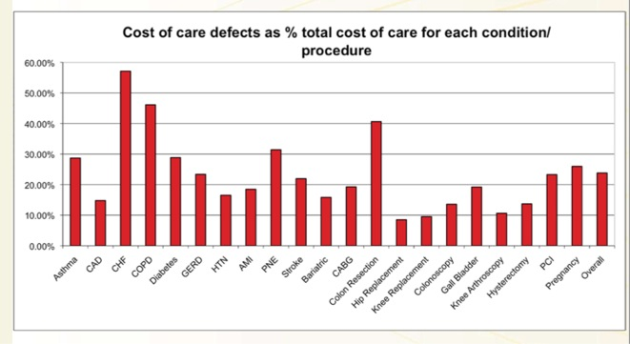
Opportunity for Shared Savings Varies by Disease
Notes:
8

Slide 10


Quality Measures Aren’t Enough
But Can’t We Simply Track the ACO Quality Measures?
ACO Measures for CHF:
  #10 = # Discharges
  #31 = Beta Blockers for LVSD
How will these two measures help you prevent CHF Hospitalizations & Readmissions?

Slide 11
Succeeding in the Era of Healthcare Reform
Improve Quality of Patient Care
Lower Costs, Higher Margins
PROACTIVELY MANAGE PATIENT POPULATIONS
IMPROVE PROVIDER PERFORMANCE
OPTIMIZE VALUE EQUATION =
QUALITY/COST
IDENTIFY AND ENSURE BEST PRACTICES
IMPLEMENT CHANGE, MEASURE /DEMONSTRATE IMPACT
Longitudinal Patient-Centered Applications with Comparative Analytics
Clinical Data
Financial Data
Operational Data
Ambulatory Care
Inpatient Care

Slide 12
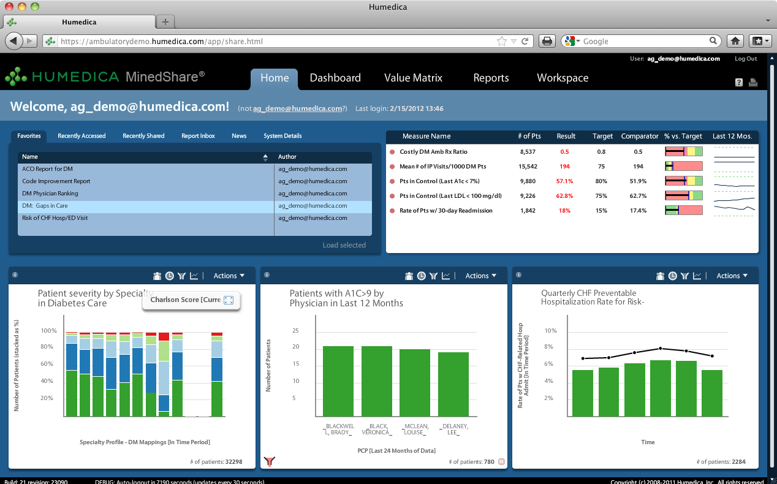
Humedica’s Innovations
Aggregate Data Across the Continuum
Clean, Normalize & Validate the Data
Transform Data Into Insight
Make Insights Actionable
Multiple data sources
Various data types
Several access methods
Numerous extraction frequencies
Mapping
Normalization
Natural Language Processing
Validation
Predictive modeling
Disease Models
Benchmarking
Shared Report Library

Slide 13
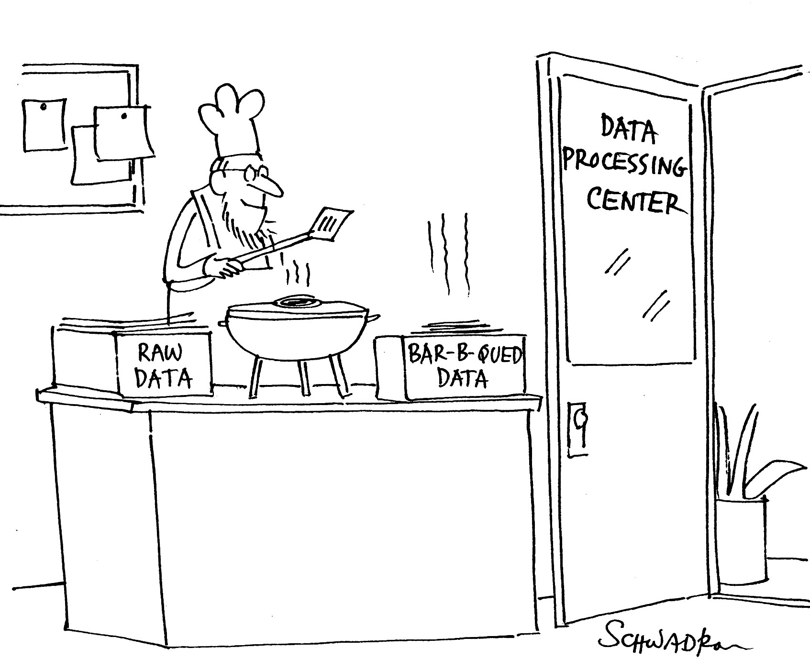
Turning raw material into finished goods – beware of the potential to get burned

Slide 14
How Challenging Can Clinical Data Be?
LOCAL NAME | LOCAL CODE |  | LOCAL NAME | LOCAL CODE
lisinolpril | 53004 |  | lisinopril 20MG | 206330
lisinop 20mg | 47650 |  | LISINOPRIL 20MG | 201887
lisinoplril | 84479 |  | lisinopril 20MG | 170309
lisinoporil | 114142 |  | LISINOPRIL 20MG TABLETS | 2619
lisinoprel | 56844 |  | Lisinopril 40 | 252035
lisinoprel 20mg | 62959 |  | lisinopril 40 mg | 247971
LISINOPRIL | 238488 |  | LISINOPRIL 40 MG | 223018
Lisinopril | 233787 |  | lisinopril 40 mg | 58406
lisinopril 10mg | 82991 |  | LISINOPRIL 40 MG TABLET | 185906
LISINOPRIL 30MG | 88777 |  | LISINOPRIL 40MG | 99596
lisinopril 10 mg | 244861 |  | LISINOPRIL 40MG TABLETS | 51301
LISINOPRIL 10 MG | 180608 |  | lisinopril 5 mg | 252165
lisinopril 10 mg | 180607 |  | LISINOPRIL 5 MG | 234939
LISINOPRIL 10 MG TABLET | 235592 |  | LISINOPRIL 5 MG TABLET | 239699
lisinopril 10mg | 129260 |  | LISINOPRIL 5.0 mgmTABLETS | 6035
LISINOPRIL 10MG | 7667 |  | lisinopril 5mg | 17488
LISINOPRIL 10MG TABLETS | 4217 |  | LISINOPRIL 5MG TABLETS | 103221
lisinopril 20 | 229320 |  | LISINOPRIL MG TABLETS | 9413
LISINOPRIL 20 MG | 229300 |  | LISINOPRIL TAB 2.5 MG U/D | 924303
lisinopril 20 mg | 227878 |  | LISINOPRIL TAB 5 MG U/D | 924305
LISINOPRIL 20 MG TABLET | 189126 |  | lisinopril tab 10 mg | 127775
lisinopril 20mg | 253427 |  | LISINOPRIL TAB 10 MG U/D (PRINIVIL) | 924306
lisinopril Tablet 5 mg | 238564 |  | LISINOPRIL TAB 20 MG U/D | 924307
lisinopril tbs | 125490 |  | LISINOPRIL TAB 40 MG (EXP) ( ZESTRIL) | 924311
lisinoprol | 17600 |  | lisinopril tablet 20 mg | 82047
lisinoril | 83965 |  | LISINORRIL | 92141

Slide 15
And Terminology is Only Part of It
LOCAL CODE | TEST NAME | NORMAL RANGE | UNIT DESIGNATION
1577876 | WHITE BLOOD CELL COUNT | 4.5-11.0 | 10^3/ml
1577876 | WHITE BLOOD CELL COUNT | See Scanned Copy-4.0-10.5 | 10^3/ml
1577876 | WHITE BLOOD CELL COUNT | -high | 10^3/ml
1577876 | WHITE BLOOD CELL COUNT | 3.6-9.6 | 10^3/ml
1577876 | WHITE BLOOD CELL COUNT | 4.5-13.5 | 10^3/ml
1577876 | WHITE BLOOD CELL COUNT | 3.3-10.5 | 10^3/ml
1577876 | WHITE BLOOD CELL COUNT | 3.4-9.8 | 10^3/ml
1577876 | WHITE BLOOD CELL COUNT | 4.8-10.8 | 10^3/ml
1577876 | WHITE BLOOD CELL COUNT | See Scanned Copy-high | 10^3/ml
1577876 | WHITE BLOOD CELL COUNT | 4.6-10.2 | 10^3/ml
1577876 | WHITE BLOOD CELL COUNT | See Scanned Copy-10.5 | 10^3/ml
1577876 | WHITE BLOOD CELL COUNT | See Scanned Copy-10.0 | 10^3/ml
1577876 | WHITE BLOOD CELL COUNT | 4.0- | 10^3/ml
1577876 | WHITE BLOOD CELL COUNT | 3.6-11.0 | 10^3/ml
1577876 | WHITE BLOOD CELL COUNT | 5-14.5 | *
1577876 | WHITE BLOOD CELL COUNT | 5.5-15.5 | *
1577876 | WHITE BLOOD CELL COUNT | 4.5-13.5 | *
1577876 | WHITE BLOOD CELL COUNT | 4.5-13 | *
1577876 | WHITE BLOOD CELL COUNT | 7.4-76.9 | 1.1
1577876 | WHITE BLOOD CELL COUNT | 8.8-71.8 | 1.2
1577876 | WHITE BLOOD CELL COUNT | 3.1-72.8 | 1.2
1577876 | WHITE BLOOD CELL COUNT | 4.2-74.3 | 1.3
1577876 | WHITE BLOOD CELL COUNT | 5.3-72.2 | 1.5
1577876 | WHITE BLOOD CELL COUNT | 12.1-56.7 | 1.5
1577876 | WHITE BLOOD CELL COUNT | 4.9-78.5 | 1.7
1577876 | WHITE BLOOD CELL COUNT | 4.6-76.7 | 1.7
1577876 | WHITE BLOOD CELL COUNT | 4.8-10.8 | 1.7
1577876 | WHITE BLOOD CELL COUNT | 5.0-62.2 | 1.7
1577876 | WHITE BLOOD CELL COUNT | 5.4-69.8 | 1.8
1577876 | WHITE BLOOD CELL COUNT | 6.4-57.7 | 1.9
These are typical unit designations for a WBC (Similar to “Weight in Pounds)
These unit designations are unintelligible and need to be examined forensically & then mapped
Also, the number of different “normal ranges” for a single test have to be mapped individually to report across the population

Slide 16


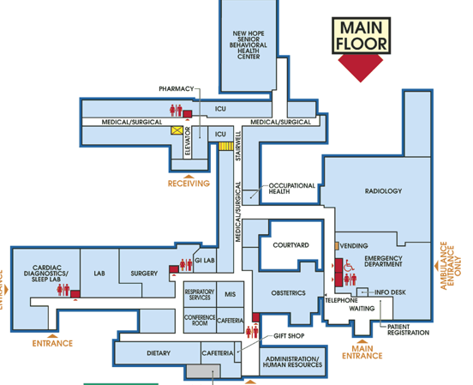
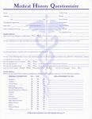
Longitudinal Patient Records
Patient Encounter
Complaints
Symptoms
Diagnosis
Vital Signs
Physician Notes
Lab & Radiology Reports
Ambulatory
Hospital-Based
Treatment triggers, therapeutic choices and associated outcomes
Pharmacy
Radiology
Patient History
Lab
ED
Demographics
Co-morbidities
Family History
Medication History
Payer/ Formulary Information

Slide 17
What Are We Missing When We Only Look at Claims Data?
 | Low | Mean | High
DM
% Pts w/ DM On Problem List and Not on Claim/Financial Data | 6% | 20% | 46%
% of Uncoded DM Patients | 22% | 32% | 52%
% of DM Pts with Clinical Evidence of a Renal Condition w/o a Code | 1% | 6% | 25%
% DM Pts Coded in 2010 but Not Coded in 2011 | 11% | 19% | 25%
CHF
% Pts w/ CHF On Problem List and Not on Claim/Financial Data | 11% | 21% | 32%
% of Uncoded CHF Patients | 27% | 35% | 43%
% CHF Pts Coded in 2010 but Not Coded in 2011 | 17% | 35% | 41%
Taken from a subset of groups

Slide 18
Opportunity Dashboard: DM
Provider Performance
Metric | Low | Mean | High
DM patients Meeting all DM Goals (HbA1c < 7.0, BP < 130/80, LDL < 100) | 14% | 18% | 21%
High Risk DM patients with no ambulatory follow-up visits | 0% | 1% | 3%
DM patients prescribed more costly drugs* | 32% | 44% | 57%
DM patients with HTN but no HTN medications | 8% | 14% | 18%
DM patients with A1c improvement of at least 2% on insulin (YOY) | 46% | 50% | 56%
DM patients with A1c > 9 on >=3 DM Meds and Not on Insulin | 16% | 33% | 42%

Slide 19


Interactive Collaborative Process – Shared Learning to Drive Improved Outcomes
Findings on Anceta wiki
(Anceta to assist with
documentation)
Further research,
publication
Prioritize follow-up
questions
Opportunity analyses
by Anceta
Your data exploration
using MinedShare
Your experience and
intuition
Collaboration
Share Best Practices
Data
Generate Hypotheses
Learning
Information
Care Process
Performance Drivers
Outcomes
Cost
Compare Improvements
Design
Interventions
Comparative Data
Action
Knowledge
Implement interventions
(local priorities/readiness)
Track impact using MinedShare
Periodic check-in with collaborators
(bi-monthly webinars, listserve)
In-person meetings q 6 months or so
Experience of colleagues
Collaborative discussion
Collaborative data exploration

Slide 20
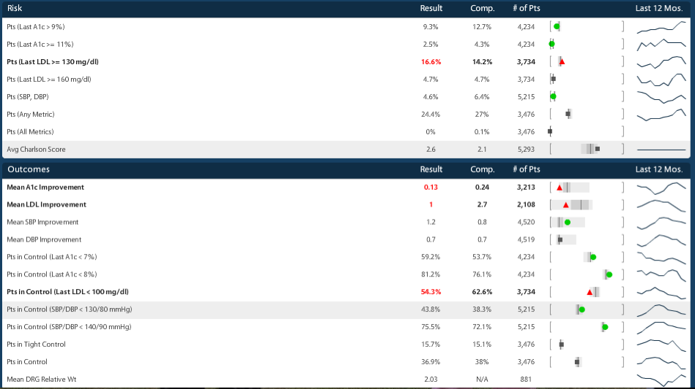
Diabetes Dashboard: Risk, Outcomes
Monitor and Track Patient Health Outcomes;
Evaluate Performance as Compared to Benchmark
Light gray box: the range of the group averages across the groups for a given metric (the “whisker”)
Dark gray box: the range of the 25th to 75th percentile of group averages for a given metric (the “box”)
Vertical black line: the median group average for a given metric
Dot (red triangle, black square, green circle): your group’s result for the metric

Slide 21
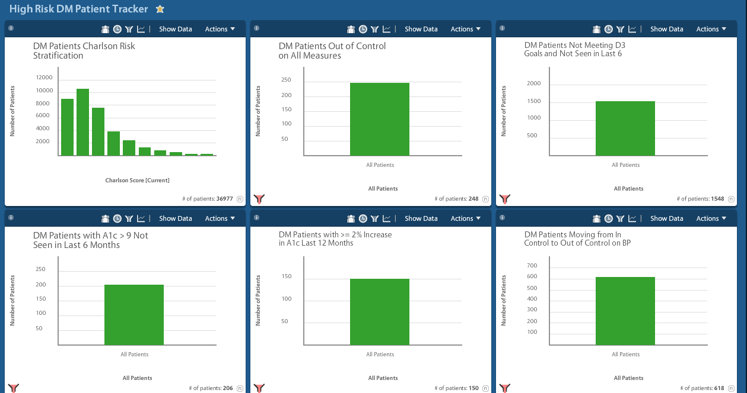
Identifying Poorly Managed Patients

Slide 22
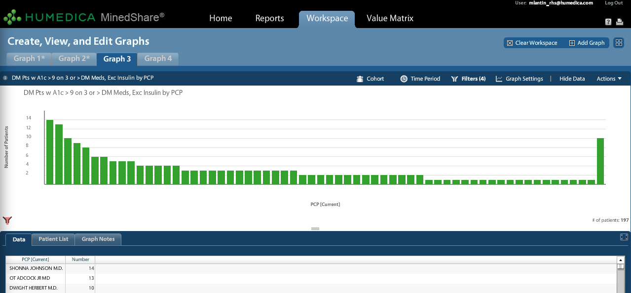
Patient-Level Data Identifies Gaps in Care and Highlights Opportunities to Manage Risk
197 patients identified with A1c > 9, on 3+ DM medications, but NOT on insulin
Which Patients Are At Risk? Which PCPs are Treating Them?

Slide 23
Diabetes Case Study: Productivity and Clinical Improvements
292 FTE Physicians
Diabetic-centered patient identification program launched using clinical data
High-Risk Diabetes cohort created
Results:
  >5000 patients identified using Humedica MinedShare
  1800 visits scheduled via Care Coordinators
  90% of scheduled patients made their appointments
  $500,000 of new revenue identified by Group
Measured year-over-year improvement for the following:
  28.9% improvement for LDL
  17.6% improvement for A1c
  30% improvement for BP

Slide 24
Code Improvement:
Importance of Baseline Coding
CMS plans to risk-adjust beneficiaries in ACOs to ensure that ACOs are not simply selecting the healthiest patients
CMS will use its Hierarchical Category Coding (HCC) mechanism developed to reimburse capitated Medicare Managed Care Plans
To prevent physicians from upcoding or favoring less sick patients, CMS will only adjust a continuously-enrolled member’s health status if the score declines.
Accurate baseline coding enables providers to receive full reimbursement

Slide 25
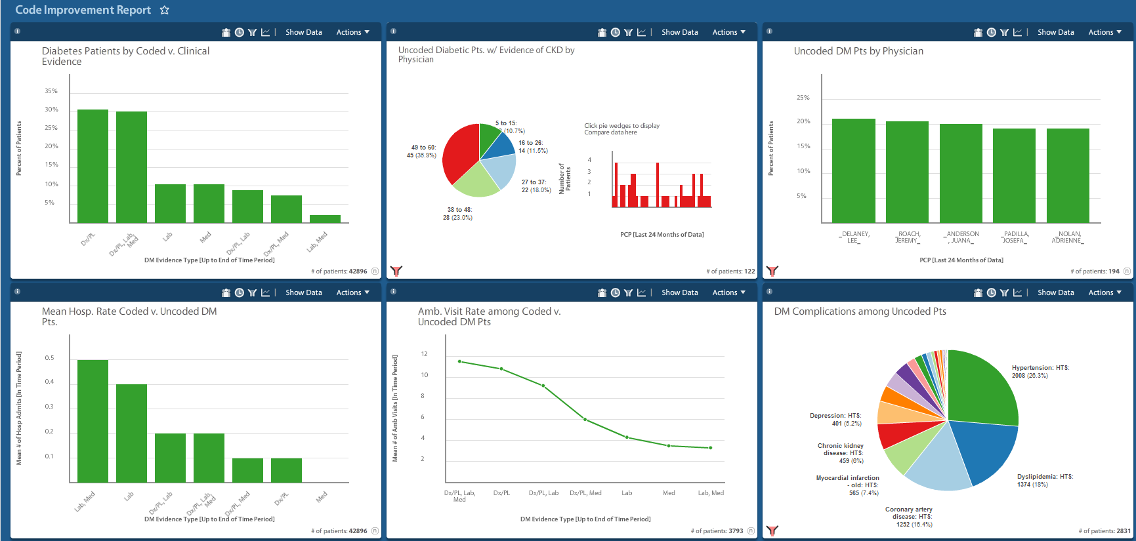
Coding Errors Create Gaps in Care

Slide 26
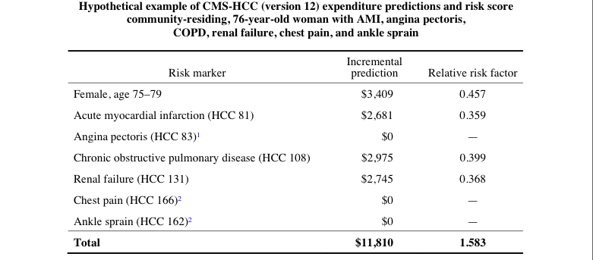
ACO Coding: Forfeited Savings
If the patient is not coded for COPD during the predicted period, the actual risk adjusted $PMPM for this patient is $831.22 vs. the expected risk adjusted $PMPM of $621.83

Slide 27
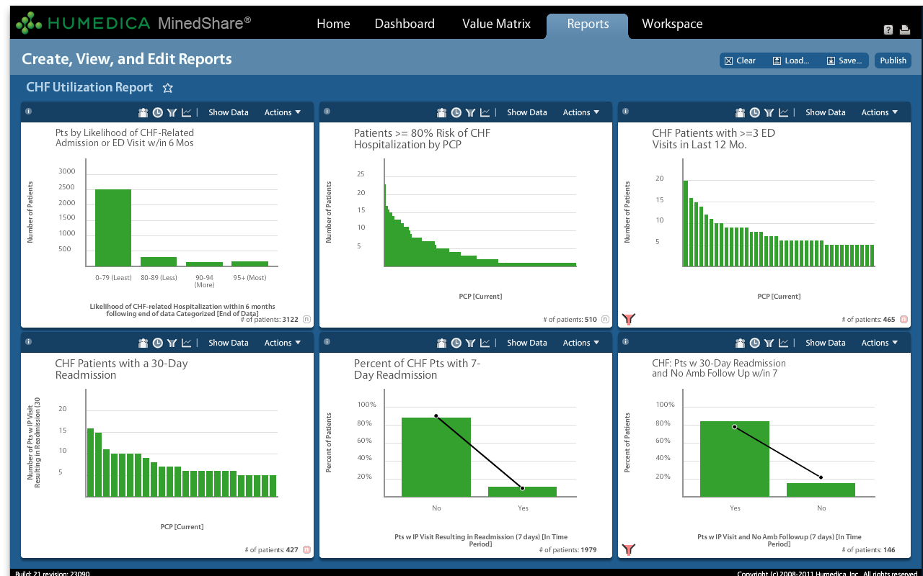
Powerful Predictive Analytics Drive Actionable Insights Example: Congestive Heart Failure
Identify Pts at Risk
Correlate Pt Risk by MD
Correlate Risk with Costs
Compare Physician Performance
Evaluate CHF Utilization Rates

Slide 28


CHF Case Study: Implementing Predictive Analytics to Optimize Interventions for High-Risk Patients
Using Humedica’s CHF predictive model to broaden view of CHF patients who may benefit from outreach
Criteria for inclusion have expanded to include patients with no past hospital utilization
  Protocols created/modified in PCMH setting to bring in patients for more intense ambulatory care

Slide 29
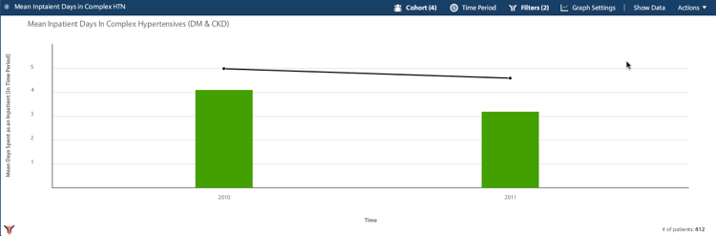
Hypertension Case Study: Productivity and Clinical Improvements
Developed a scalable process for identifying and tracking patients with hypertension
Operational gains estimated at 25-30% savings in time per month to analyze the hypertension population
Provide hypertension control reports to individual practices and physicians
Facile quantification of improved clinical outcomes

Slide 30
What to Focus on First?
Opportunity Assessment
  Identify high utilizers and care transition opportunities
  Evaluate resource utilization against clinical outcomes
  Track impact of care redesign
Code Improvement
  Identify gaps in coding
  Identify uncoded patients that belong to different disease cohorts who are at risk
Cohort Analytics
  Identify clinical, demographic, and risk profiles of different disease cohorts
Gaps in Care
  Identify patients who are not receiving standard care by site of care and provider
PCMH/High Risk Patient Management
  Track high risk poly-chronic patients
  Identify actionable clinical opportunities for care coordinators
  Intervene with patients at highest risk for preventable admissions
Physician Scorecards
  Quickly evaluate physician performance in process and outcomes of care
Analysis of Prescribing Patterns
  Identify drug prescribing patterns vis-à-vis clinical outcomes
  Track compliance against medication protocols

Slide 31
Scorecard for Success
Integrate, Clean and Present All Necessary Data with Minimal IT Burden
Reveal and Predict the True Risks in My Population
Help Me to Optimize Payments by Improving my Risk Scores
Help Me Close Gaps in Care & Optimize my Performance on Measures
Empower Me to Optimize my Physician Network
Help Me Ensure Best Practices
Help Me Identify Higher Than Expected Costs/Resource Utilization
Help Me Prove the Clinical & Financial Value of the Care We Deliver to our Key Stakeholders
Empower Me to Optimize Contracts with Payers

